Slide 1
Sales Analytics

Slide 2
Problem Statement
The objective of this project is to create a visually appealing and user-friendly Power BI dashboard that effectively communicates key performance metrics for Northwind Traders.
The dashboard aims to provide insights into:
Customer behavior
Sales patterns
Employee performance
It will cover:
Sales analysis
Customer segmentation
Inventory trends
Employee performance
The goal is to consolidate data from multiple tables to deliver a comprehensive view of business operations and support data-driven decision-making.

Slide 3
Data Understanding
The project uses the Northwind Traders dataset, which contains transactional data related to sales, customers, products, employees, suppliers, and shipping.
Key Tables:
Customers – Customer details such as name, city, and country
Orders – Order information including order date and shipping details
Order Details – Product-level transaction data (quantity, price, discount)
Products – Product details, pricing, and stock information
Categories – Product classification
Employees – Employee details and reporting hierarchy
Suppliers – Supplier information and location
Shippers – Shipping company details used to deliver orders
Important Fields Used:
Unit Price, Quantity, Discount ,Order Date, Shipped Date ,Customer Location (City, Country)

Slide 4
Data Preparation
The dataset was cleaned and transformed using Power Query to ensure accuracy and consistency before analysis.
Steps Performed:
Removed null and duplicate values from important columns
Handled missing data in fields like Order Date and Unit Price
Removed unnecessary columns to improve performance
Converted data types:
Dates → Date format
Prices → Decimal
Quantity → Whole number
Created derived columns:
Year
Month
Renamed columns for better readability
Loaded cleaned data into the data model

Slide 5
Data Modeling
The data model was designed using a structured approach to connect multiple tables and enable efficient analysis.
Key Relationships:
Customers → Orders (CustomerID)
Orders → Order Details (OrderID)
Products → Order Details (ProductID)
Products → Categories (CategoryID)
Orders → Employees (EmployeeID)
Fact Table:
Order Details (contains transactional data like Quantity, Unit Price, Discount)
Benefits:
Enables accurate calculations
Supports filtering across visuals
Improves report performance

Slide 6
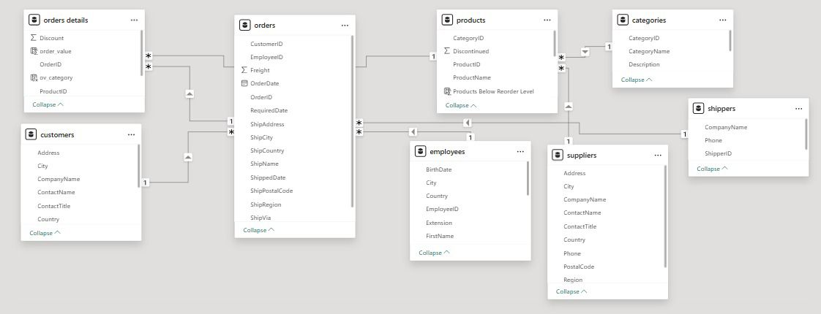
CONNECTIONS IN POWER BI

Slide 7
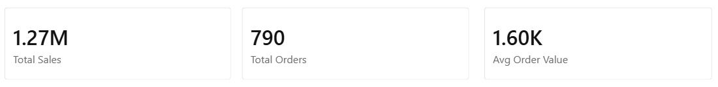
Key Measures (DAX)
DAX (Data Analysis Expressions) was used to create key measures for analyzing business performance.
Base Measures:
Total Sales = Sum of (Unit Price × Quantity × (1 – Discount))
Total Orders = Count of Order IDs
Total Customers = Distinct count of Customer IDs
Total Quantity = Sum of Quantity
Calculated Measures:
Average Order Value (AOV) = Total Sales ÷ Total Orders
Shipping Duration = Difference between Order Date and Shipped Date
Purpose:
Enables accurate calculations across visuals
Helps track KPIs and performance metrics
Supports data-driven insights

Slide 8
SQL Analysis
SQL was used to perform exploratory data analysis (EDA) on the Northwind dataset before building the Power BI dashboard.
Key Analysis Performed:
Calculated total sales and revenue trends
Identified top customers based on spending
Analyzed sales by country and city
Found top-performing products and categories
Evaluated employee performance based on orders
Analyzed supplier distribution and pricing
Purpose:
To extract meaningful insights from raw data
To validate data before visualization
To support dashboard development

Slide 9
Excel Analysis
Microsoft Excel was used for initial data exploration and validation before building the dashboard.
Key Tasks Performed:
Data cleaning (handling missing values and duplicates)
Created Pivot Tables for quick analysis
Analyzed sales by country, category, and customer
Calculated basic metrics like total sales and order count
Used filters and sorting to identify top and low-performing data
Tools Used:
Pivot Tables
Sorting & Filtering
Basic formulas (SUM, COUNT, AVERAGE)
Purpose:
Quick data exploration
Validation of results and Supporting analysis before visualization

Slide 10
Conclusion
This project successfully delivers an interactive and comprehensive dashboard for analyzing the business performance of Northwind Traders.
The analysis provided insights into:
Customer behavior and purchasing patterns
Sales trends across regions and time
Product and category performance
Employee contribution to business growth
By integrating SQL, Excel, and Power BI:
Data was effectively analyzed and validated
Insights were clearly visualized through interactive dashboards
Business decisions can be supported with data-driven evidence
The dashboard helps identify key trends, optimize operations, and improve overall business performance.

Slide 11
THANK YOU

